Slide 1
Introduction to WP1
Analysis of water resources management in the Western Balkan region
Priv.-Doz. DI Dr. Michael Tritthart
University of Natural Resources and Life Sciences BOKU, Vienna
Meeting Vienna / 8th May 2019
This project has been funded with support from the European Commission. This publication reflects the views only of the author, and the Commission cannot be held responsible for any use which may be made of the information contained therein.

Slide 2
Overview
Content
Identification of Western Balkans regional issues related to water resources management
The general overview of existing successful models of education in the field of WRM of EU HEIs and comparative analysis with the existing curricula in WB partner countries
Three-day workshop on innovative practices in the EU water sector
Basics
for preparing trainings of professionals in water sector in WB partner countries.
for the definition and development of the new courses and master curricula in WB countries.

Slide 3
WP1 – Tasks
Analysis of water resources management in the Western Balkan region
1.1 Identification of WB regional issues related to WRM
WB partners in cooperation with BOKU | 14.04.2019 (Report)
P
1.2 Analysis of EU innovations in water policy and EU recommendations and legislation in water sector
EU partners in cooperation with BOKU | 14.04.2019 (Report)
P
1.3 Analysis of existing curricula related to WRM in both EU and WB partner countries
EU and WB partners in cooperation with BOKU | 14.05.2019 (Report)
1.4 Identification of needed laboratory resources in WB HEIs and alignment with formed EU HEIs WRM laboratory equipment list
EU partners in cooperation with BOKU | 14.03.2019 (Report)
P
1.5 Workshop on innovative practices in the EU water sector: barriers and opportunities
Three-day workshop in Vienna in May 2019 | 14.06.2019 (Report)

Slide 4
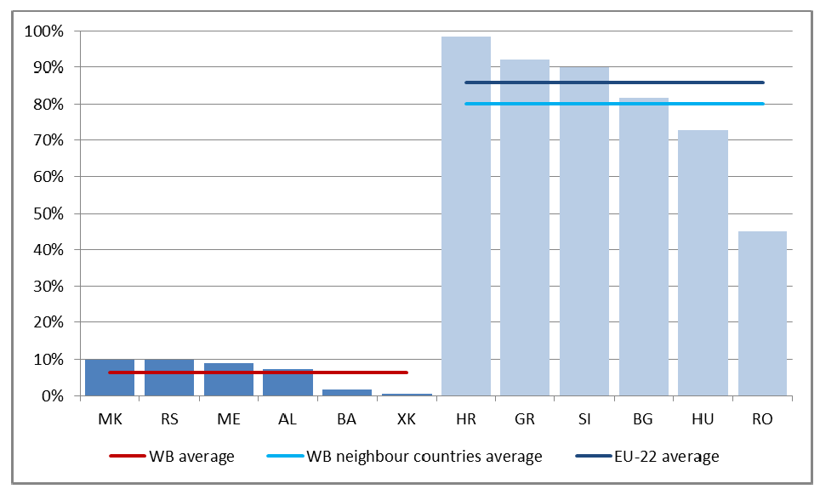
1.1 Identification of WB regional issues related to WRM
State of the water resources
Status of the water resource services
Issues related to water management
Review of
responsible institutions,
their staff
and needed qualifications
14.04.2019 (Report)
P
Figure: Share of population connected to waste-water treatment
in the year 2012 (Globevnik et al. 2018, ETC/ICM Technical Report)

Slide 5
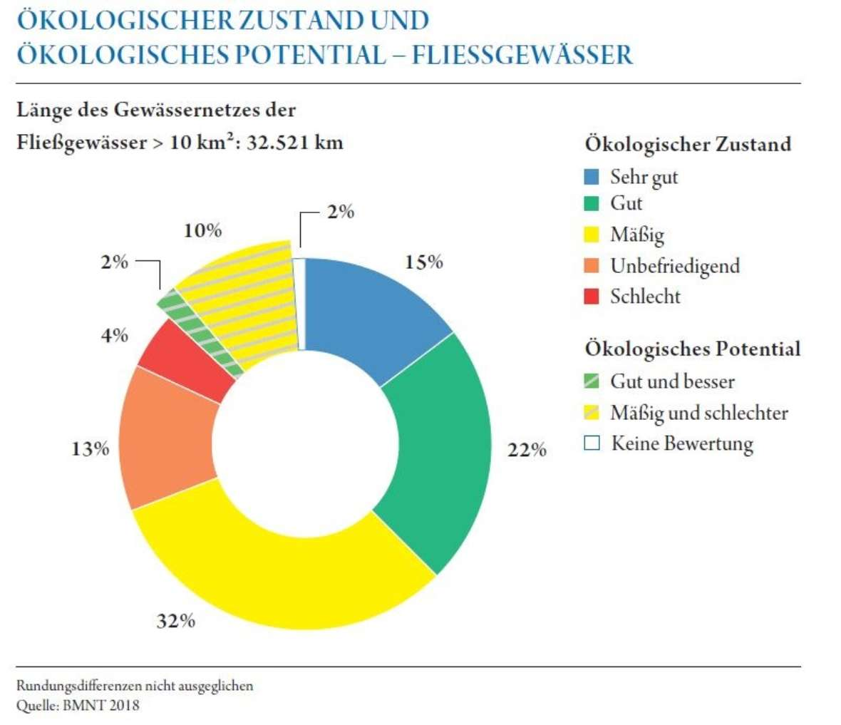
1.2 Analysis of EU innovations in water policy and EU recommendations and legislation in water sector
Analysis of EU legislation in WRM
(Water Framework Directive, EU Water Scarcity and Droughts Policy, Drinking Water Directive, etc.)
Implementation in
EU project partners countries
Roadmap for
further project initiatives
(e.g. preparing of trainings
for professionals)
Status of rivers
very good
good
moderate
poor
bad
Potential of rivers
good
14.04.2019 (Report)
moderate/poor
P
no info
Figure: Ecological status and
potential of rivers (>10km²) in Austria (BMNT, 2018)

Slide 6
1.3 Analysis of existing curricula related to WRM in both EU and WB partner countries
Comparative analysis
of structure and model of EU/WB curricula
Definition of needs
of existing study programmes
List of EU curricula
(Catalogue of Courses)
including teaching methods
and laboratory equipment
14.05.2019 (Report)
Table: Relevant master´s programmes in Austria
Master´s programme | Academic degree | University
Civil Engineering and Water Management | MSc | University of Natural Resources and Life Sciences, Vienna
Alpine Natural Dangers / Watershed Regulation | MSc | University of Natural Resources and Life Sciences, Vienna
Geotechnical and Hydraulic Engineering | MSc | Graz University of Technology
Civil Engineering | MSc | Vienna University of Technology
Environmental Engineering | MSc | University of Innsbruck

Slide 7
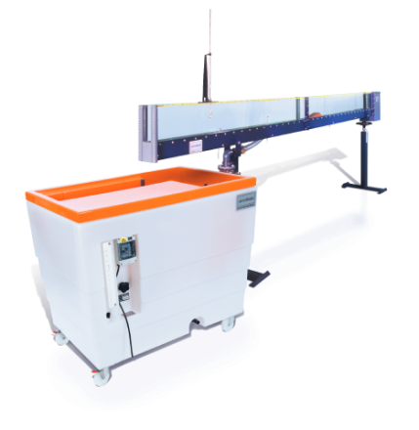
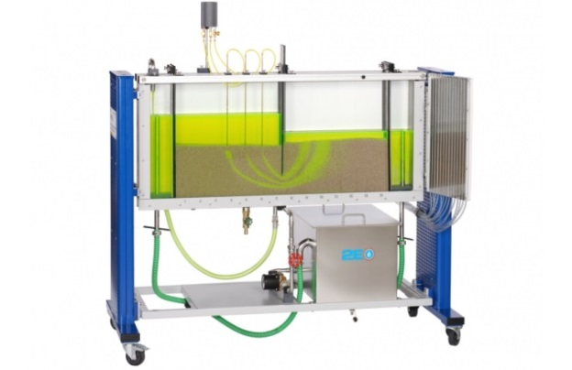
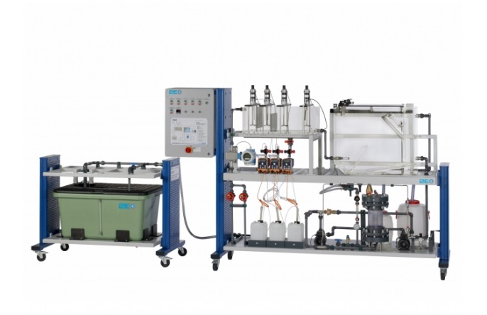
1.4 Identification of needed laboratory resources in WB HEIs and alignment with formed EU HEIs WRM laboratory equipment list
Specification of
  Laboratory equipment list
  Software
  Literature
Prerequisite for
public procurement
procedures execution
Figure: Open channel flow
Figure: Seepage flow
14.03.2019 (Report)
P
Figure: Water treatment – Mechanical process

Slide 8

1.5 Workshop on innovative practices in the EU water sector: barriers and opportunities
Cooperation between educational sector
and professional bodies
Engagement of water management professionals
  Educational topics
  Future incorporation in education
JUST NOW ☺
14.06.2019 (Report)
© Interreg Slovenia - Austria

Slide 9
WP1
1.1 Identification of WB regional issues related to WRM
WB partners in cooperation with BOKU | 14.04.2019 (Report)
1.2 Analysis of EU innovations in water policy and EU recommendations and legislation in water sector
EU partners in cooperation with BOKU | 14.04.2019 (Report)
Thank you very much for your contribution!
1.3 Analysis of existing curricula related to WRM in both EU and WB partner countries
EU and WB partners in cooperation with BOKU | 14.05.2019 (Report)
1.4 Identification of needed laboratory resources in WB HEIs and alignment with formed EU HEIs WRM laboratory equipment list
EU partners in cooperation with BOKU | 14.03.2019 (Report)
1.5 Workshop on innovative practices in the EU water sector: barriers and opportunities
Three-day workshop in Vienna in May 2019 | 14.06.2019 (Report)

Slide 10

Contact information
University of Natural Resources and Life Sciences Vienna (BOKU)
Department of Water, Atmosphere and Environment (WAU)
Institute of Hydraulic Engineering and River Research (IWA)
Find more about us in
http://www.wau.boku.ac.at/en/
Michael Tritthart
Priv.-Doz. Dipl.-Ing. Dr.techn.
E-mail: michael.tritthart@boku.ac.at
Kurt Glock
Dipl.-Ing.
E-mail: kurt.glock@boku.ac.at

